Slide 1

Exploring Public Opinions of Remote Study During Covid-19
Sentimental Analysis of Social Media Posts
Team: Jiecheng Gu, Xiaomeng Niu
Notes:
Hi, everyone! I'm Jiecheng Gu
I’m Xiaomeng Niu
Today our topic is Exploring public opinions of remote study– a sentimental analysis of social media posts.
By social media, here it refers to Twitter and Weibo.
Weibo is a Chinese Twittwe like platform.

Slide 2
Why this topic?
Fair distribution of educational resources
Better educational environment
Develop personal learning plans
Better time management skills
Notes:
First of all, we want to talk about why we want to choose this topic.
E-learning is not a fresh topic but what if it become part of our daily life?
Almost every one of us have experienced the time when we stay at home alone and facing computer all day.
And I believe you all understand the urgent of atucally speak to people, right?
We want to explore public’s opinion about remote study to see what aspects can be improved.
Because we believe when e-learning becomes popular and adapted to more senarios,
it can bring benefits to the whole society AND individuals.
1. We believe remote study can be the solution to fair education. For children in rural areas, they can receive bettter eduacation through screens
2. This will also save money for schools in rural area so that they can upgrade their facillities
3. If university adpats online teaching form, students’ scheduel will be more flexible and have more chance to discover their true interest and take advanage of it.
4. This flexible learning style will also be the chane to practice time management skills, which is important skill in students’ future life.

Slide 3
Contents
Data Collection and Preprocessing
Data Modelling and Analysis
Conclusions
Notes:
Next we will share our study methods and findings.
First we will talk about how we collect and preprocess data
And how did we model the data and which aspects did we analyze
Lastly, we will share our conclusions and thoughts

Slide 4


Data Collection
and
Preprocessing
Notes:
So let’s begin with our collection steps

Slide 5
Data Collection
Weibo API
Create a Weibo APP and get a unique key
Request authentication and access API
Web Crawler
Login using a Weibo account and get cookies
Simulate login using cookie
Start searching for key-words-related content
Twitter API
Apply for a Twitter Developer account
(for academic research)
Request authentication and access API
Return and parse JSON data
Store returned data in CSV format
Notes:
For Twitter, we first apply a developer account to use its APIs for academic research. Then we request authentication and access API, and it returns JSON data contains information about user and tweet. Then we store the data in CSV format.
The API interface provided by Weibo is limited to 2,000. Therefore, we also utilized a web crawler written in Python code. The main idea is first login Weibo and copy the cookie to our program. And then simulate the login process and search for data. The data returned was also stored in a CSV file.

Slide 6
Data Collection
添加你的小标题
Time Range
Twitter Keywords
online learning
remote learning
distance learning
#onlinelearning
#remotelearning
#distancelearning
6 months in total:
2020.9 ~ 2020.11
2021.2 ~ 2020.4
Data Volume
Weibo Keywords
Twitter:
336,556 tweets
162,980 users
Weibo: 162,363 posts
Online Learning (网课)
Notes:
The time ragne we set for this project is 6 months: from September 2020 to November 2020 and from Feburary 2021 to April 2021.
The filter keywords and hashtags we used to collect Tweets are “online learning", "remote learning", "distance learning", “#onlinelearning”, “#remotelearning”, and “#distancelearning”.
For Weibo, we searched for “online learning” related contents.
In total, 336,556 unique tweets posted by 162,980 unique Twitter users were sampled and 162,363 Weibo posts were fetched.

Slide 7
Preprocessing
Remove Duplicates & Missing Data
Remove Redundant Characters
Unify all contents in Simplified Chinese
Word segmentation — Jieba python toolkit
Data denoise – remove characters and advertisements
Remove stop words – Dictionary form HIT
Notes:
To preprocess Twitter data, we first dropped duplicates and rows containing None value and then cleaned the texts of tweets. Then, we removed redundant characters such as ‘@’(mentions), '#' (hashtag), ‘RT’ (retweets), hyperlinks, emojis, and punctuations. We only keep the punctuations for future analysis.
For Weibo data, we first unify all the sentences by translating traditional Chinese into Simplified Chinese. Different from English, Chinese sentences are continuous and do not have spaces to separate words.
Therefore, the next step is word segmentation. We use the Jieba word segmentation toolkit, which is highly efficient and has high accuracy.
The third step is data denoise. We remove useless characters as we did to Twitter data. We also remove obvious advertisements by recognizing keywords like “price”, “after discount”, and “fans”.
And the last step is to remove stop words, which are functional words without actual meaning. Here we used a stop words dictionary from the Harbin Institute of Technology.

Slide 8
Data Modelling and Analysis
Notes:
Now let’s take a look at how we model and analyze these data we have.

Slide 9
Twttier Sentiment Score
Model
VADER [Hutto and Gilbert, 2014]
Score Range
from –1 (most negative) to +1 (most positive)
Three groups
positive (score > 0)
neutral (score= 0)
negative (score < 0)
Notes:
The first thing we do is calculate the sentiment score.
We used a model named VADER to perform the process. The score range is from -1 to 1, where -1 is the most negative and 1 is the most positive.
We divide the scores into 3 groups, positive which are greater than 0, negative which are less than 0 and neutral which are equal to 0.

Slide 10
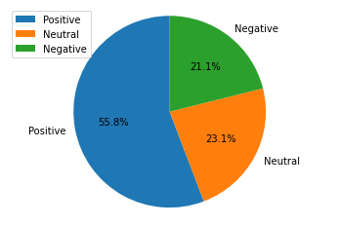
Twitter Sentiment Score
Statistics
Average sentiment score | 0.289
Standard deviation | 0.461
25th percentile | 0
50th percentile | 0.262
75th percentile | 0.647
Notes:
Here are our results. The left pie chart represents the score distribution. We can see that more than half of the posts are positive, about ¼ are negative, and the rest are neutral.
On the right side is the statistical numbers. The average score we get is 0.289 which is slight positive; the std of our data is 0.461, meaning the small volatility.
We also calculate 25th percentile, which is 0, and our 50th percentile is 0.262 that is close to our average. The 75th percentile is 0.647.

Slide 11
Weibo Sentiment Score
Use Three Dictionaries
BosonNLP sentiment words dictionary
Semantic dictionary from National Taiwan University
A degree word dictionary from Dalian University of Technology
Drop Extreme Values
Frist and last 5% values
Five Ranges
extreme positive (score < -4.02)
positive (-4.02<= score < 2.35)
neutral ( 2.35 <= score < 8.72)
negative (8.72 <= score < 15.10)
extreme negative (score >= 15.10)
Notes:
However, we cannot apply the VADER model to our Weibo data since it is in Chinese. Instead, we choose three sentimental dictionaries to calculate the score.
Because we concatenate scores from 3 dictionaries, the scores are scattered. Therefore, we dropped first and last 5% from our values, to avoid the effect from extreme values.
The we divide the score range into 5 categories: extreme positive (score < -4.02), positive (-4.02<= score < 2.35), neutral ( 2.35 <= score < 8.72), negative (8.72 <= score < 15.10), and extreme negative (score >= 15.10)

Slide 12
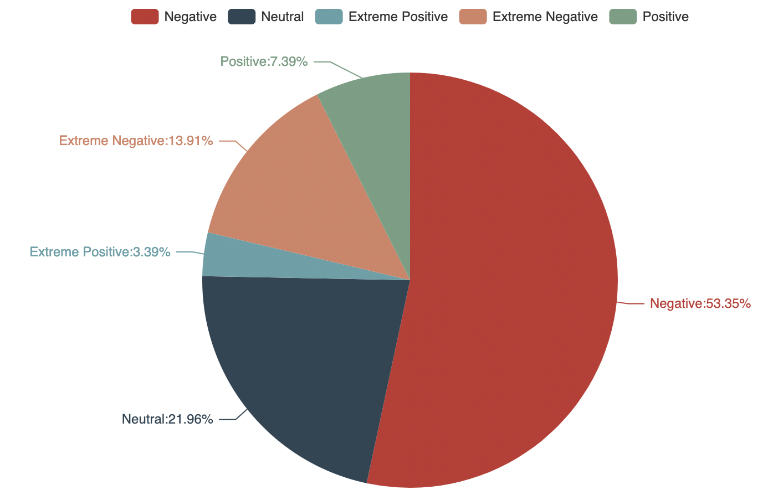
Weibo Sentiment Score
Stastistcs
Maximum: 21.47
Minimum: -10.39
Average: 1.38
25th percentile: 5.88
75th percentile: 10.05
Notes:
The maximum score is 21.47, minimum score is -10.39, and the average value is 1.38. The 25th percentile value is 5.88 and the 75th percentile value is 10.05. From the pie chart figure, we can tell more than half of the posts are having negative attitudes, whereas almost ¼ of people hold neutral attitudes and the rest are positive about online learning.

Slide 13
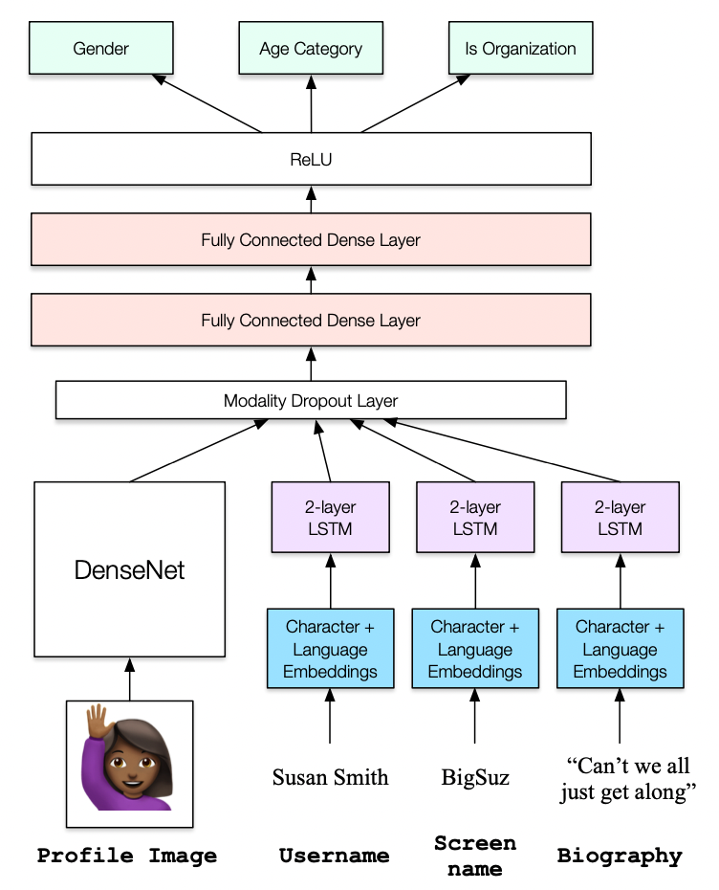
User Features
Model: M3-inference model
Used on Twitter user data
Based on users’ profile name, username (screen name), and profile description
infer their gender, age, and user status(organization or individuals).
Notes:
Then we analyze Twitter user features using M3 model. The model takes inputs such as profile image, username/ screen name and biography to infer user’s gender, age, and status (organization or individuals).

Slide 14
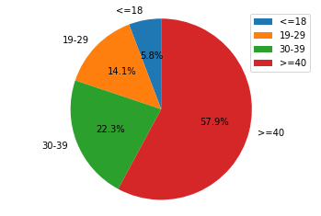
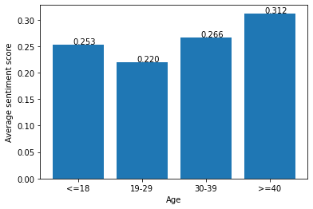
User Features – Age
Age Group Distribution
Avreage Scores of each age group
Notes:
Here on the left shows the distribution of the age distributions. We can see that people older than 40 post most about remote study and they also have the higher average sentiment score among these age groups. People aging from 19 to 29 have the least average score which means more negative opinions are posted in this group.

Slide 15
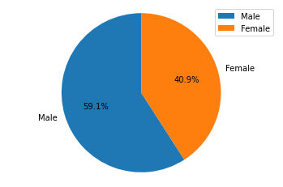
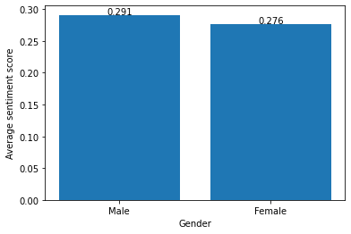
User Features – Gender
Gender Distribution
Avreage Scores of each gender
Notes:
From the pie chart, we can see that almost 60% of the users are men and 40% are women. While the average scores among gender groups are very close, score from female group is slightly lower.

Slide 16
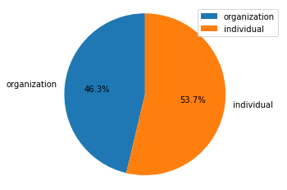
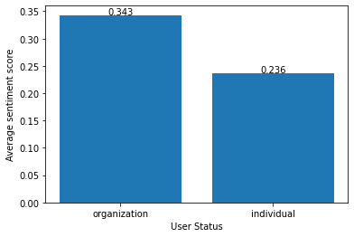
User Features – Status
Status Distribution
Average Scoresof each user status
Notes:
From the status distribution, we can tell that more than half of users are individuals. And the average score from organization user is higer.

Slide 17
Regression Analysis
Predictor | Coefficient | P-value
Gender (0=female, 1=male) | 0.0102 | 0.207
Age (<=18) (0=no, 1=yes) | -0.1202 | 0.000
Age (30-39) (0=no, 1=yes) | -0.0749 | 0.000
Age (>=40) (0=no, 1=yes) | -0.0530 | 0.000
User Status (organization=0, individual=1) | 0.0207 | 0.005
Constant | 0.3109 | 0.000
F-statistics | 23.74 (p value < 0.001)
R-squared | 0.007
Adjusted R-squared | 0.007
Notes:
We also used ordinary least squares regression analysis on our Twitter dataset to discover relationship between VADER sentiment scores and user characteristics. We can see that the predictor variable of users’ age and users’ status is significant since the p value is below the common alpha level of 0.05. This regression results also show that as age increases, people are significantly more positive about remote study.

Slide 18
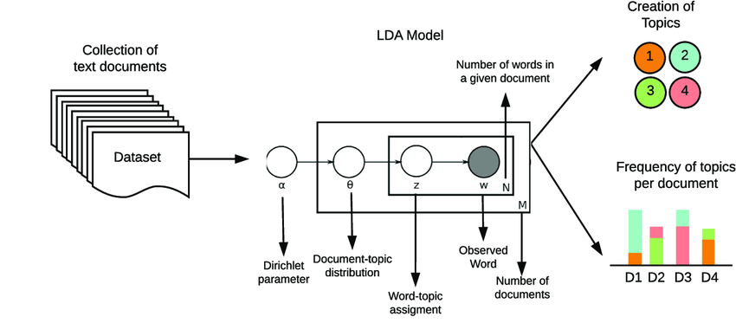
Topic Modelling
LDA (Latent Dirichlet Allocation)
Notes:
We use LDA (Latent Dirichlet Allocation) to extract topics from texts.

Slide 19
Twitter Topic analysis
Topic# | Topic title | Topic keywords
1 | Pandemic and schools | cases, covid, schools, pandemic, positive, coronavirus, students, university
2 | Online teaching classes (e.g., zoom) | zoom, today, video, live, morning, google, students, check, class, week
3 | Online certificates and webinars | free, join, webinar, certificate, course, register, virtual, training
4 | Health and safety | health, safety, mental, education, kids, open, higher, spread
5 | Support and help | support, help, access, need, resources, internet
6 | Studying at home | kids, homeschooling, education, math, problem, energy efficiency, chance
Notes:
Here are our six major topics of tweets and their corresponding topic keywords. They are “Pandemic and schools”, “Online teaching classes”, “online certificates and webinars”, “health and safety”, “suport and help”, and “studying at home”.

Slide 20
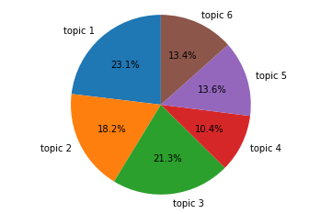
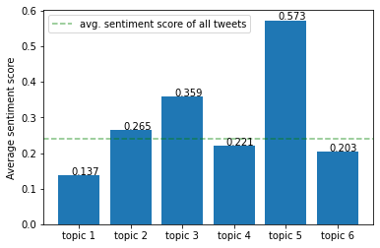
Twitter Topic analysis
Topic Distribution
Avreage Scores
Notes:
Let’s look at the distribution of these topics. Topic 1, topic 2 and topic 3 account for over 60% of all the tweets.
The right graph is the average sentiment score of tweets of each topic in Twitter data. The average sentiment score of all tweets we fetched is 0.239.
We see that the average sentiment scores of tweets of topic 1, 4, and 6 are under the average score. Among them, topic 1 got the lowest score with 0.137, and we can infer that the covid pandemic has a negative impact on people’s attitudes towards remote study.

Slide 21
Weibo Topic analysis
Topic # | Topic | Keywords
1 | Qualification Exams | 教资 考研 资格证 专升本 面试 小学 粉笔
2 | Schoolwork | 作业 考试 复习 开学 学期 打卡 上课 课程 发现
3 | Entertainment | 视频 微博 直播 推荐
4 | School and covid-19 | 军训 第一课 校园网 宿舍 开学 学校 疫情 教室
5 | Teacher and students | 老师 学生 孩子 教师 同学
Notes:
For Weibo data, The first topic refers to qualification or certificate exams, including keywords like “teaching certificates” and “graduate school entrance exam”.
Topic 2 can be summarized as schoolwork containing words such as “homework”, “exam”. Similarly, topic 4 and topic 5 are similar to topic 2: topic 4 has keywords like “school”, “dormitory”, and “classroom”; and topic 5 contains keywords like “teachers” and “students”. The keywords in topic 4 tend to describe buildings on campus, and topic 5 is related to people in school, while topic 2 focuses more on study assignments.
Topic 3 is unique among these topics, which has keywords such as “video”, “Weibo”, and “streaming”. We used the word entertainment to represent this topic.

Slide 22
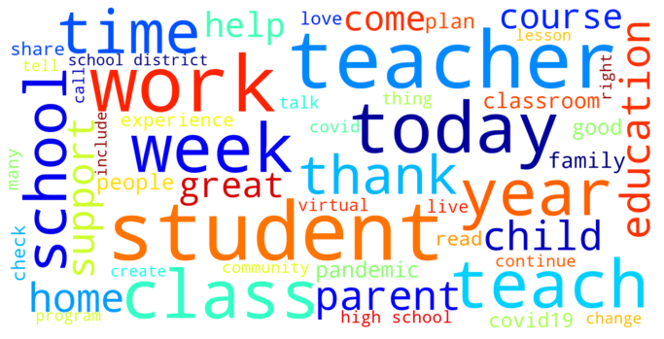

Word Frequency
Twitter Wordcloud
Weibo Wordcloud
Notes:
Additionally, we also used word cloud to represent the most frequent words from our data. Notice that we dropped the keywords like “remote learning”, “distance learning” and “online learning” from the list of the top words since they are already the top words. In a word cloud, the frequency of each word is represented by its size. This means that the bigger the word is, the more people use it in remote-study-related posts. The left one is extracted from Twitter data, and the right one is from Weibo.

Slide 23
Conclusion
Notes:
Now let’s review our conclusions.

Slide 24
Conclusion
Opinions on remote sduty vary from different user groups
Users aging from 19 to 29 think the most negative
Users >= 40 have the most positive attitude
As age increases (>18), people are significantly more positive about remote study
Male users post more than female users
Avg. sentiment score of females are slightly lower
Individual users post more than organization users
Individual group has lower avgerage sentiment score
Notes:
First, the opinions are different among different user groups.

Slide 25
Conclusion
Chinese students have more negative opinions
Online learning platforms are more popular in the U.S.
people get used to the remote study style
Limited number and high price of airlines, 14-21 days quarantie policy
some students have not been back home for almost 2 years
In China, remote study often accompanied by lockdown
cannot go elsewhere but stay at home
Chinese users often take online classes to pass qualification exams
Notes:
There are significant differences in the sentiment scores distributions between Weibo and Twitter. The primary attitude among Twitter users is positive, but the main attitude from Weibo users is negative. The reason are as

Slide 26
Future Work
Applying an algorithm to filter some ads-related tweets
More features could be included in future analyses (e.g., ethnicity and family income)
Do a fine-grained sentiment analysis to find the exact emotions peopel expressed
Notes:
There are also some potential improvements in our studies.

Slide 27
ANY
COMMENTS
QUESTIONS
Notes:
Any Questions? Comments?

Slide 28
Thanks for your attention!
Notes:
Well, that’s all for our presentation. Thanks for your attention!

Slide 29
Reference
1. Yeung, N., Lai, J. and Luo, J., 2020. Face Off: Polarized Public Opinions on Personal Face Mask Usage during the COVID-19 Pandemic. arXiv.
2. Hutto, C. and Gilbert, E. 2014. VADER: A Parsimonious Rule-Based Model for Sentiment Analysis of Social Media Text. Proceedings of the International AAAI Conference on Web and Social Media. 8, 1 (May 2014), 216-225.
3. Zijian Wang et al. 2019. Demographic inference and representative population estimates from multilingual social media data. The World Wide Web Conference (2019). DOI: http://dx.doi.org/10.1145/3308558.3313684
4. Elsalem, L., Al-Azzam, N., Jum'ah, A., Obeidat, N., Sindiani, A. and Kheirallah, K., 2020. Stress and behavioral changes with remote E-exams during the Covid-19 pandemic: A cross-sectional study among undergraduates of medical sciences. Annals of Medicine and Surgery, 60, pp.271-279.
5. Trzcińska-Król, M., 2020. Students with special educational needs in distance learning during the COVID-19 pandemic – parents’ opinions. Interdyscyplinarne Konteksty Pedagogiki Specjalnej, (29), pp.173-191.
6. Morgan, H., 2020. Best Practices for Implementing Remote Learning during a Pandemic. The Clearing House: A Journal of Educational Strategies, Issues, and Ideas, 93(3), pp.135-141.
7. Henderson, C., Kim, G., Zarrella, G., and Burger, D.. 2011. Discriminating Gender on Twitter. Association for Computational Linguistics, pp.1301–1309. URL: https://aclanthology.org/D11-1120
Notes:
Here are our references.

